Slide 1
Google Sketchup
Tara Geidel

Slide 2
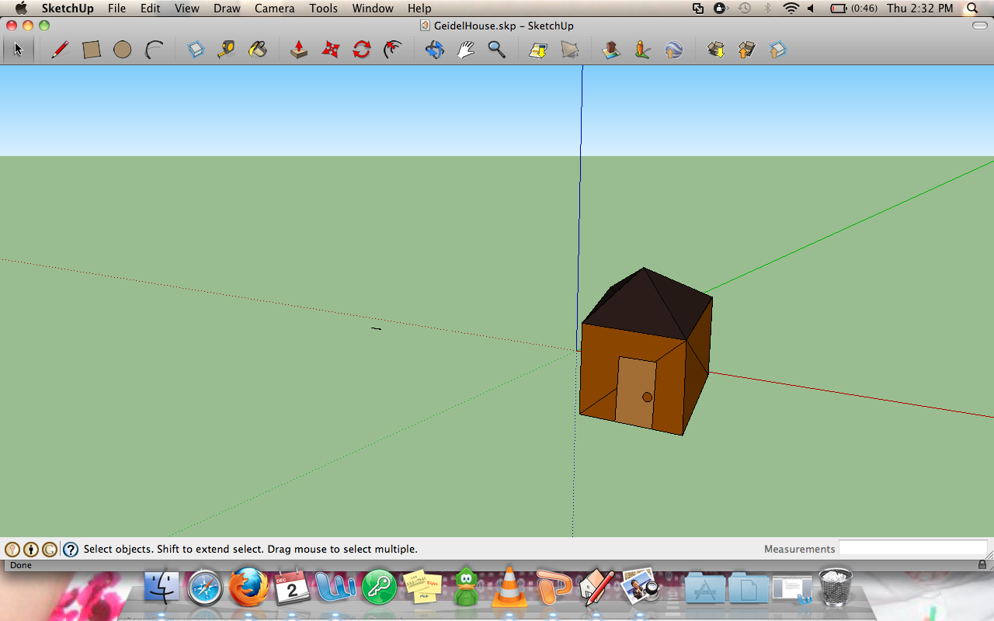

Slide 3
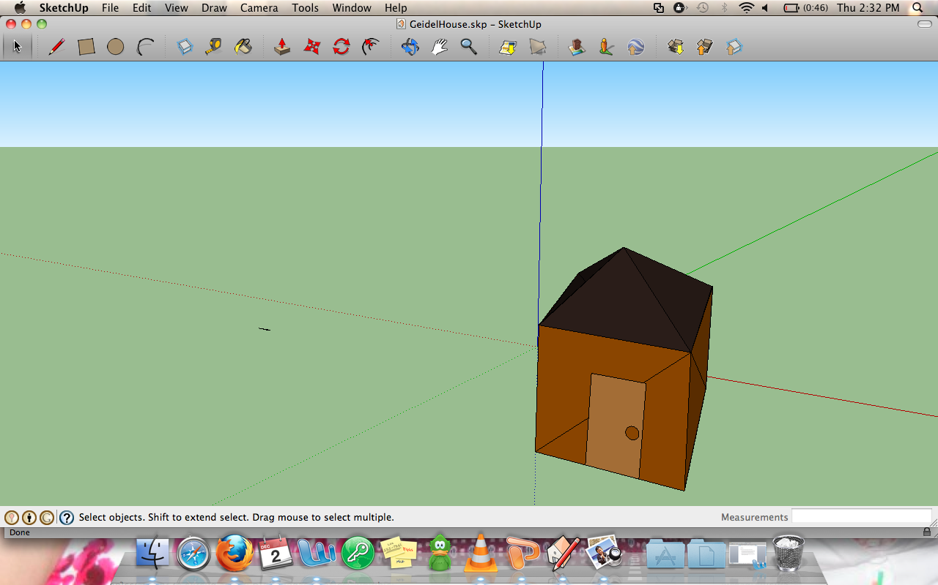

Slide 4
