Slide 1
Second Life
Tara Geidel

Slide 2
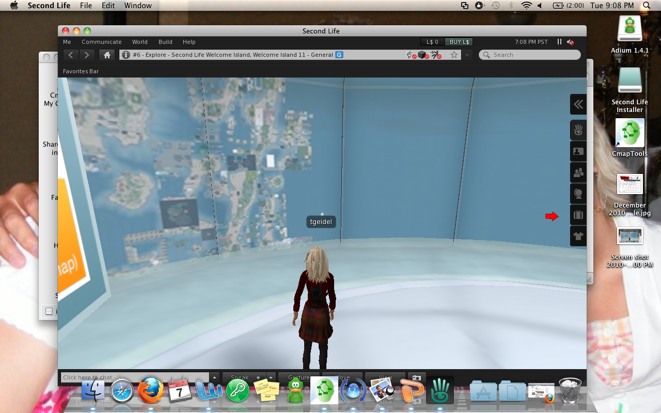
Hypothesis: Thought that I could go to the map and pick a place to go.

Slide 3
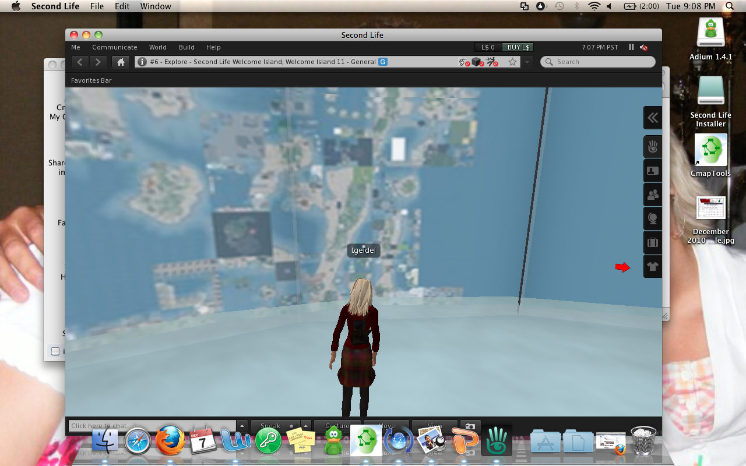
Hypothesis was wrong! I could not click on anything on the wall.

Slide 4
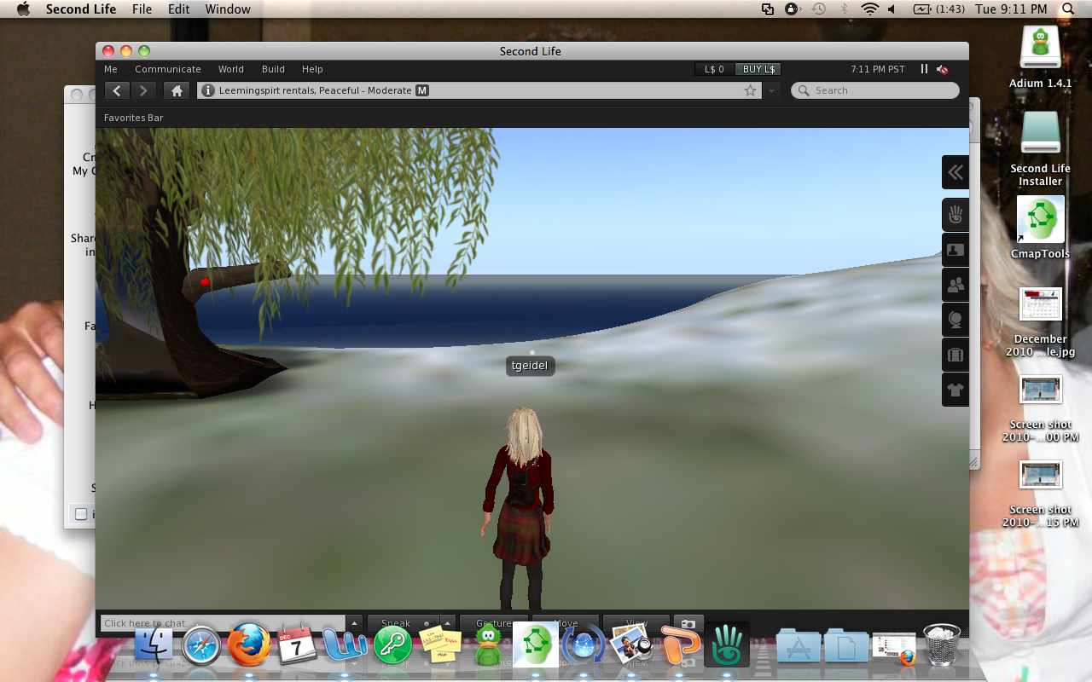
Hypothesis: I think that I can walk to the water and swim.

Slide 5
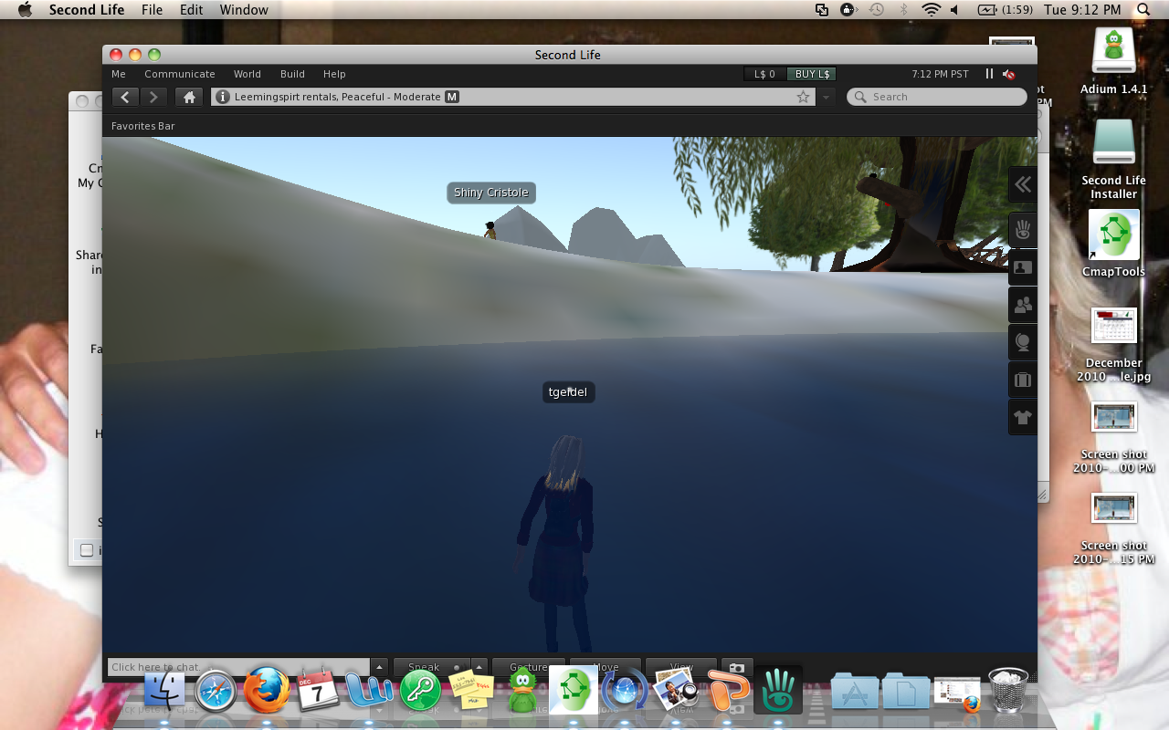
Hypothesis is right! I could walk in the water and see what was in it.

